Slide 1

Traffic Analysis and Severity Prediction
Thinkful Final Capstone
Genesis Taylor

Slide 2
Background
The UK government collects and publishes (usually on an annual basis) detailed information about traffic accidents across the country. This information includes, but is not limited to, geographical locations, weather conditions, type of vehicles, number of casualties and vehicle maneuvers, making this a very interesting and comprehensive dataset for analysis and research.
The data for this project is available on Kaggle as UK Road Safety: Traffic Accidents and Vehicles

Slide 3
Importance of Analyzing Traffic Accidents
Accurately analyzing accidents can help governments to better the safety of their roads and highways.
Identifying high areas of accidents and high areas of accident severity can highlight areas of concern.
It can also be beneficial to insurance companies looking to change their rates in different areas.

Slide 4
Agenda
The goal of this project is to investigate and determine what causes accidents and what attributes to their level of severity.
Through visualizations and machine learning algorithms, areas of concern will be highlighted, and the seriousness of accidents will be predicted as accurately as possible.

Slide 5
Data Introduction Details
The data for this project is obtained from a user on Kaggle and was composed from information on the United Kingdom’s Government Open Data website.
It consists of two different datasets that contain information from 2005-2017 that were combined on a common field (accident_index).
Vehicle_Information.csv: A file containing information about the vehicles, point of impact, maneuvers made, driver information, etc.
Accident_Information.csv: A file containing details about the accident that include location, junction details, date and time, accident severity, etc.

Slide 6
Research Questions
What are the limitations of the current data?
What things would help this research to be more accurate?
Can we forecast the number of accidents in upcoming years based on the information available?
Who does this project benefit?
Can we create a machine learning algorithm that correctly predicts the severity of accidents?
When do/did the most accidents happen?
How do the available factors contribute to accident seriousness?

Slide 7
Who does this project benefit?
Government Departments of Transportation
Create safer highways
Prevent fatalities
Reduce severity
Educate the public

Slide 8
When do/did the most accidents happen?
The following charts display the number of accidents by year, month, season and day of the week.
The trends for each time period are displayed for analysis and reviews.

Slide 9
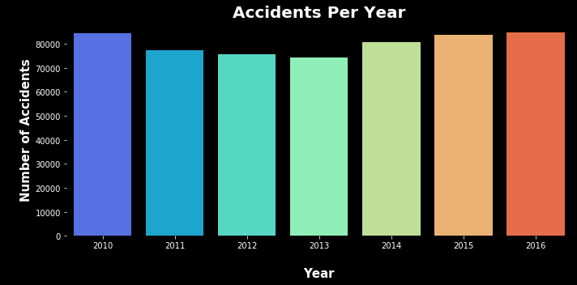
Accidents per Year
According to the graph above, from 2010 to 2013, there was a decrease in the number of accidents, however over the past few years there has been an increase in accidents, with 2016 being close to the 2010 numbers.

Slide 10
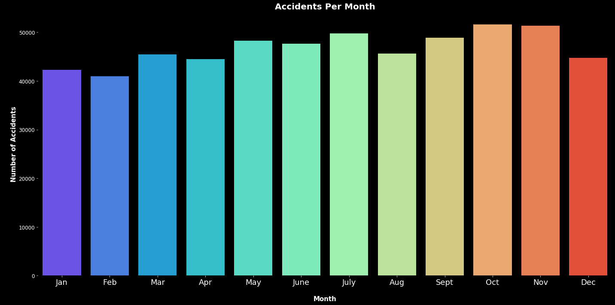
Accidents per Month
According to the graph above, the majority of accidents happen between May and July and September and November.

Slide 11
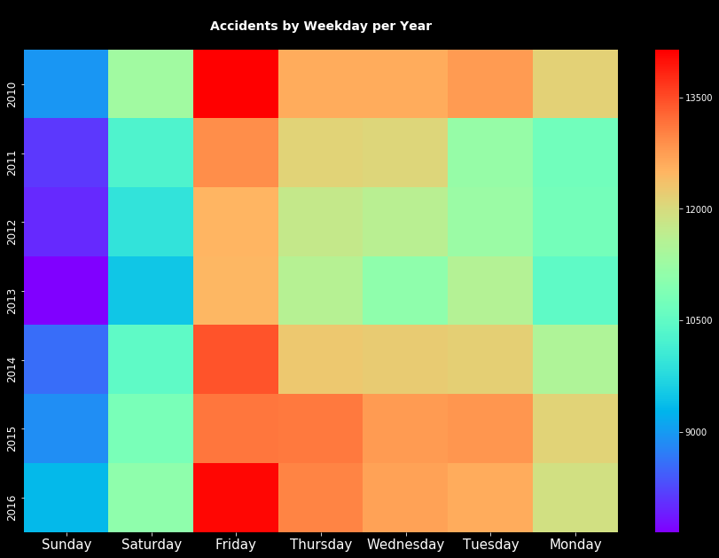
Accidents Per Weekday Per Year
Fridays are the day of the week where the most accidents occur in each year. More information can help to explain this occurrence better.

Slide 12
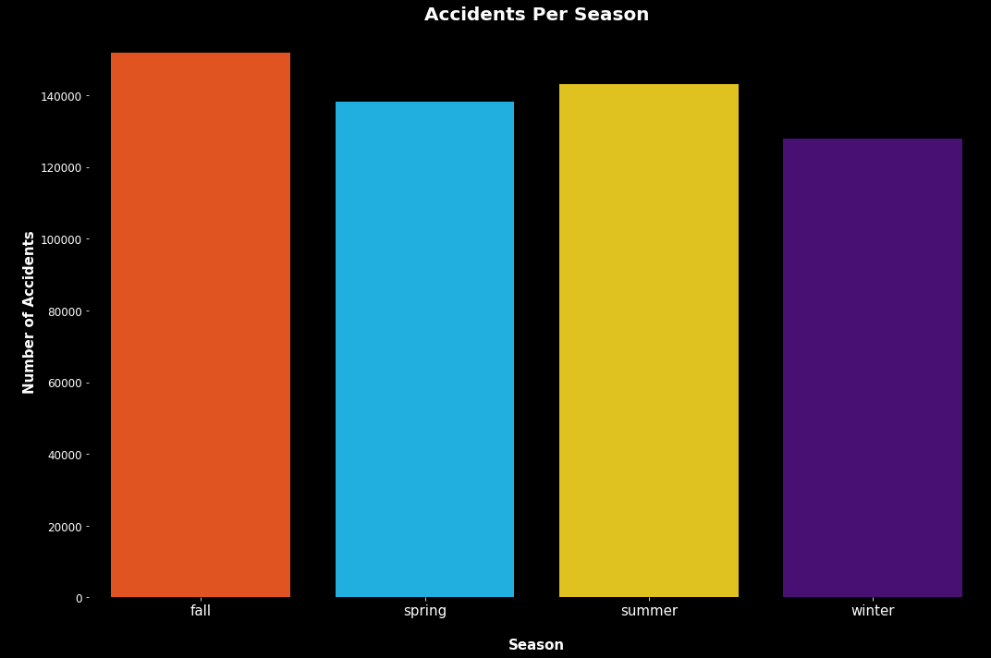
Accidents Per Season
Summer and Fall have the highest number of accidents. These match with the accidents per month and are something for governments to look at closer and compare to whatever events are in the area.

Slide 13
How do the available factors contribute to accident seriousness?
did_police_officer_attend_scene_of_accident
x1st_point_of_impact
number_of_vehicles
speed_limit
urban_or_rural_area
skidding_and_overturning
vehicle_leaving_carriageway
sex_of_driver
vehicle_type
vehicle_manoeuvre
engine_capacity_cc
number_of_casualties
driver_home_area_type
age_band_of_driver
junction_control
hit_object_off_carriageway
hit_object_in_carriageway
driver_imd_decile
junction_detail
junction_location
propulsion_code
year
These features were found to have the highest relation to accident seriousness. While they may all have an impact, not every feature will be discussed in the following slides. The features discussed will be based on the findings from their visualization. For visual reasons, two separate dataframes were created, for not serious and serious accidents. I wanted to better scale the data and for me, this was the simplest way of doing so.

Slide 14
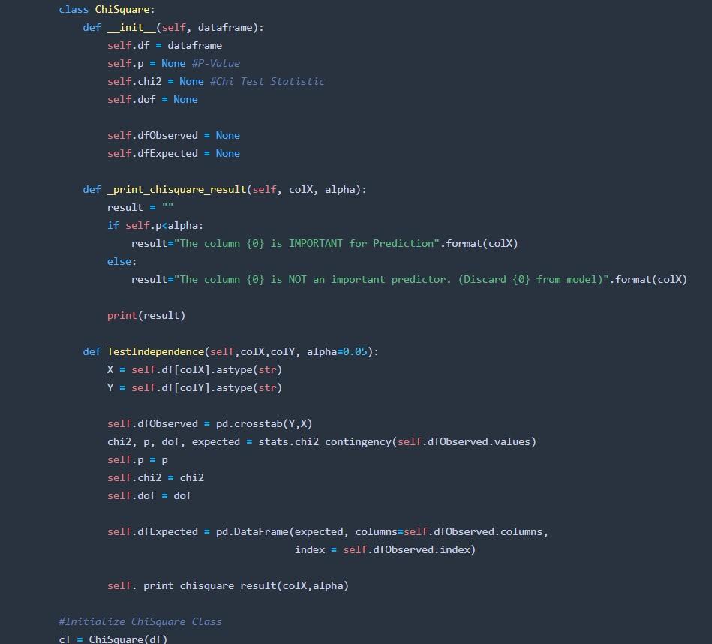
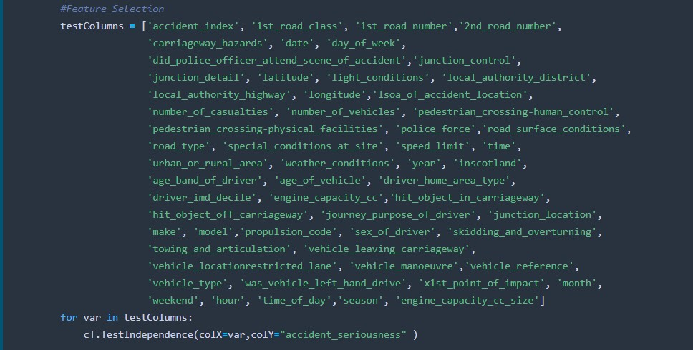
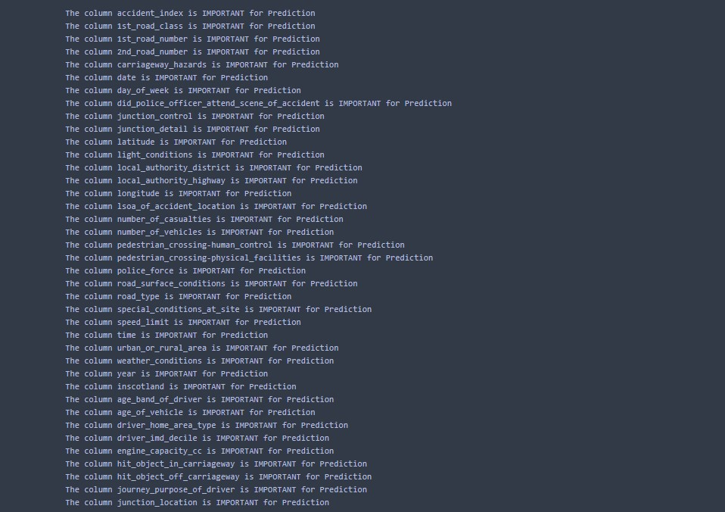
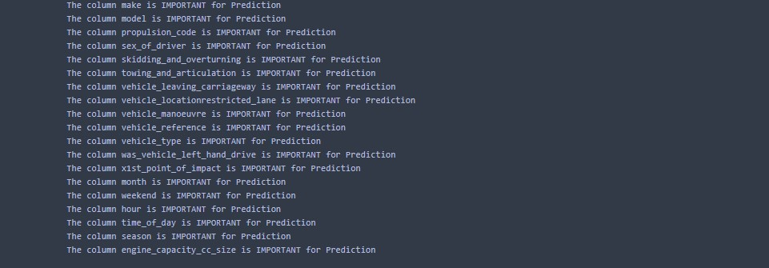
How do the available factors contribute to accident seriousness?
After getting these correlations, I ran them through a Chi-Squared test to check for relevance. Above are screenshots of the coding, and the results. With a requirement of p being < 0.05, all features were deemed important enough for prediction, so I continued with my visualization comparisons.

Slide 15

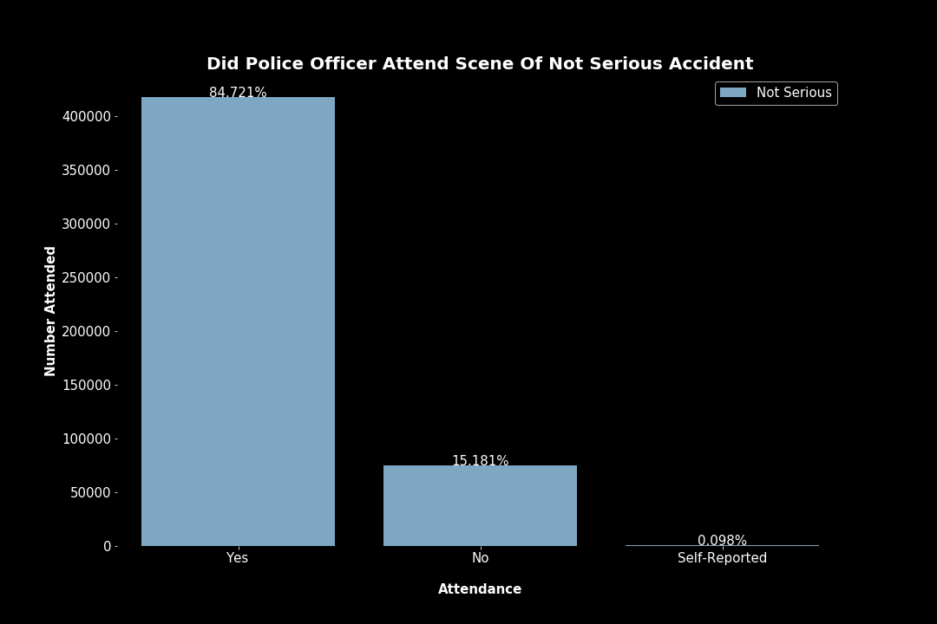
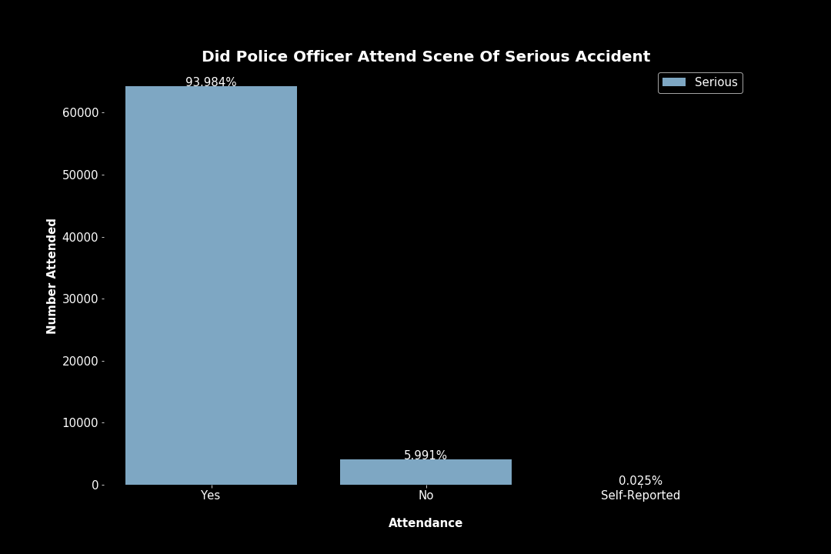
Did Police Officer Attend Scene Of Accident
Police attended most accidents but were less likely to NOT be called in serious accidents.

Slide 16
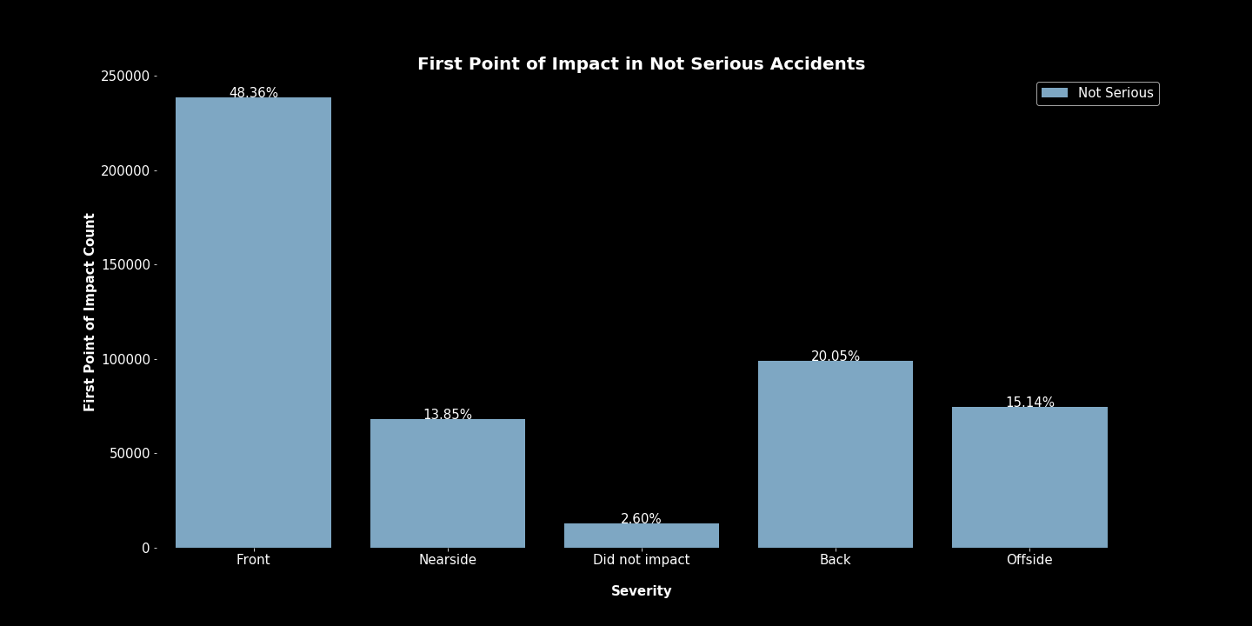
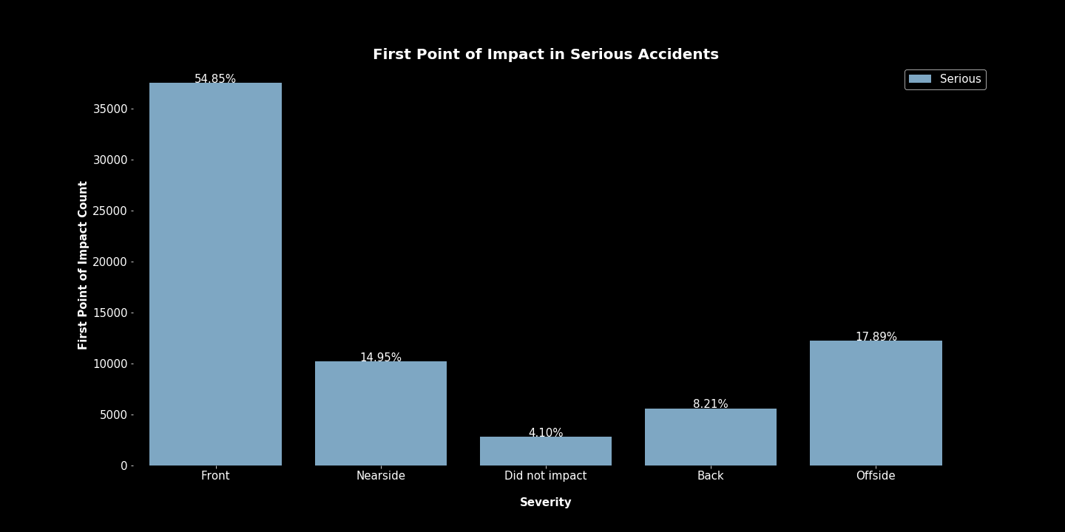
First Point of Impact
Majority of accidents were front impacted as the first point of impact. Not serious accidents had a higher percentage of Back impact accidents than serious accidents. Serious accidents had higher percentages of Offside and Nearside accidents.

Slide 17
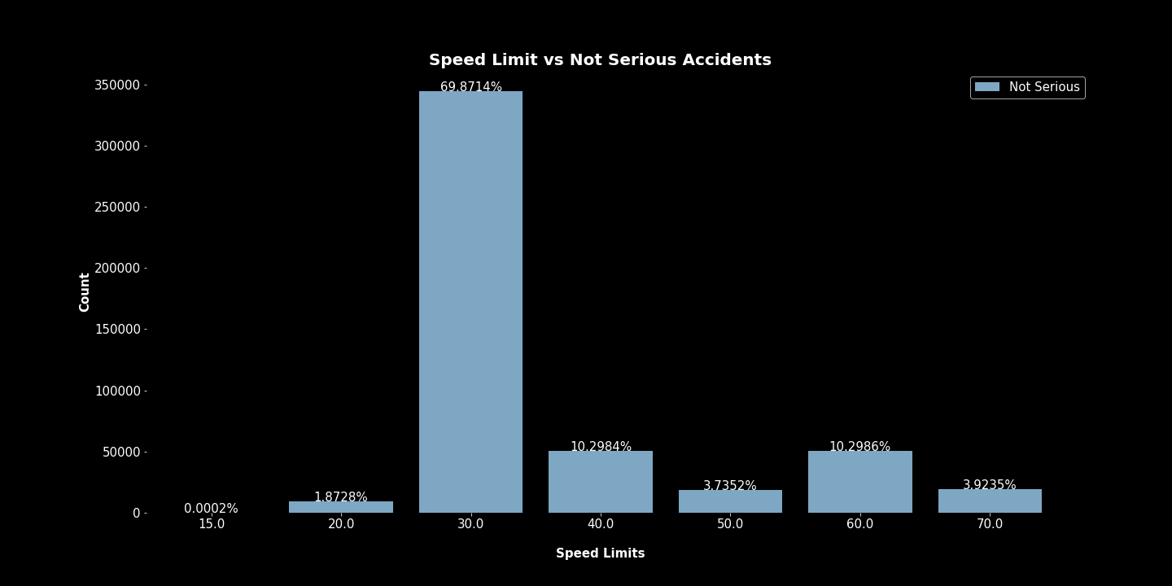
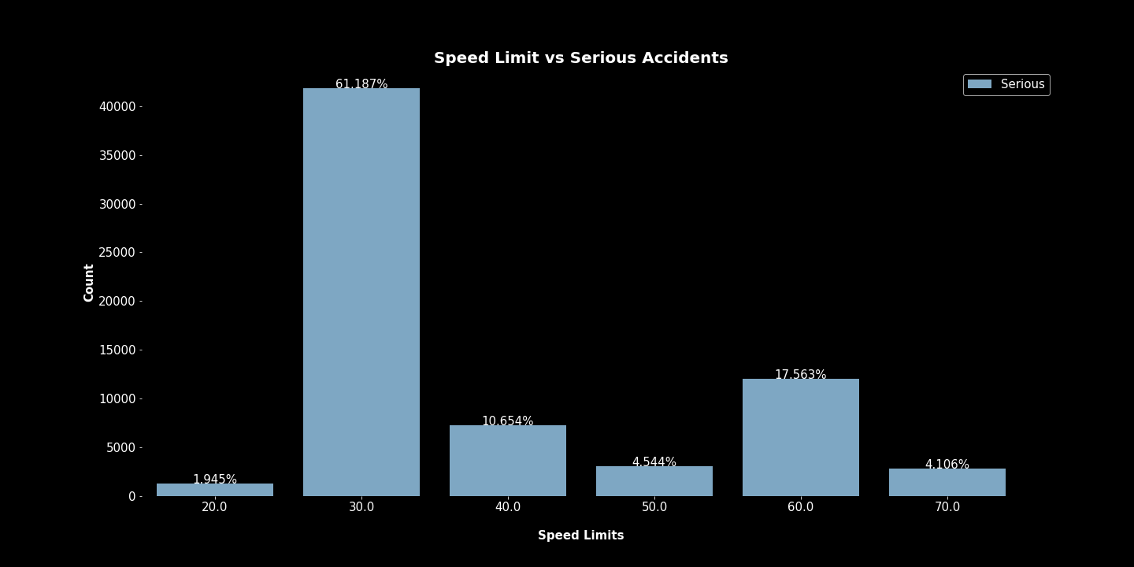
Speed Limit
Majority of accidents occurred in 30 speed limit zones. It would have been beneficial to have actual data on the speeds of the vehicles involved or at least if they were speeding.

Slide 18
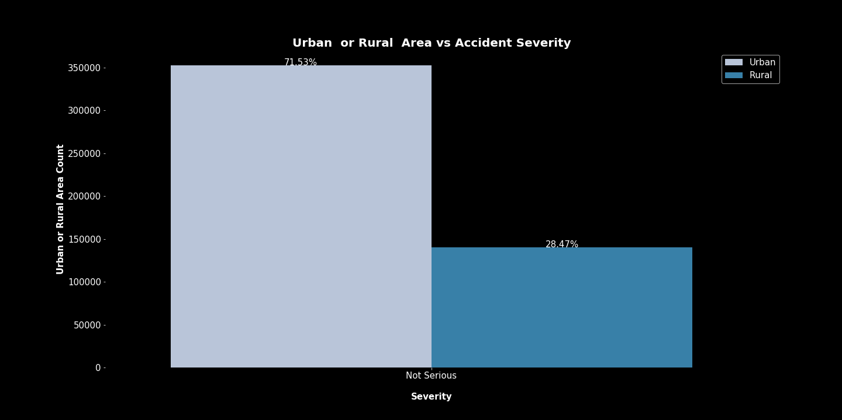
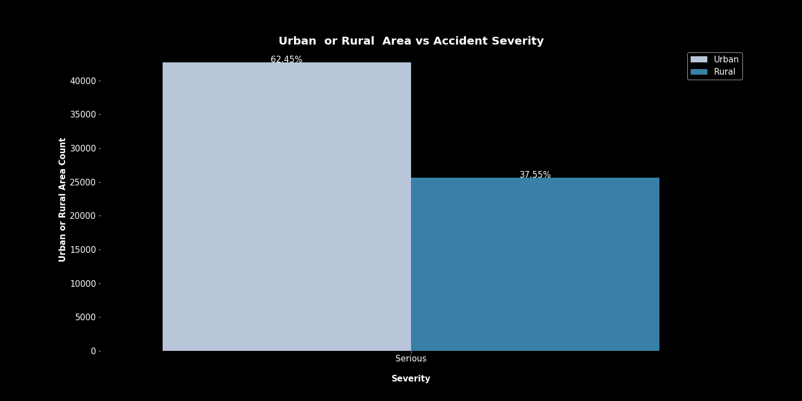
Urban or Rural Areas
Rural areas had a higher percentage of serious accidents. This may relate to hospital locations or emergency vehicle arriving to the scene of the accident, both of which are not available through this data.

Slide 19
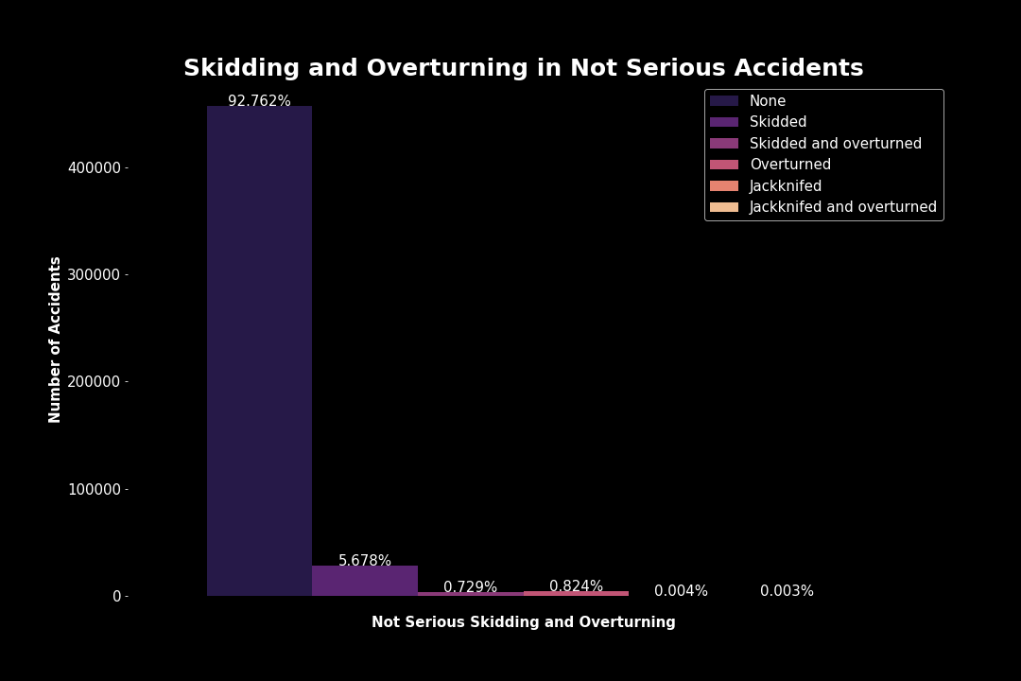
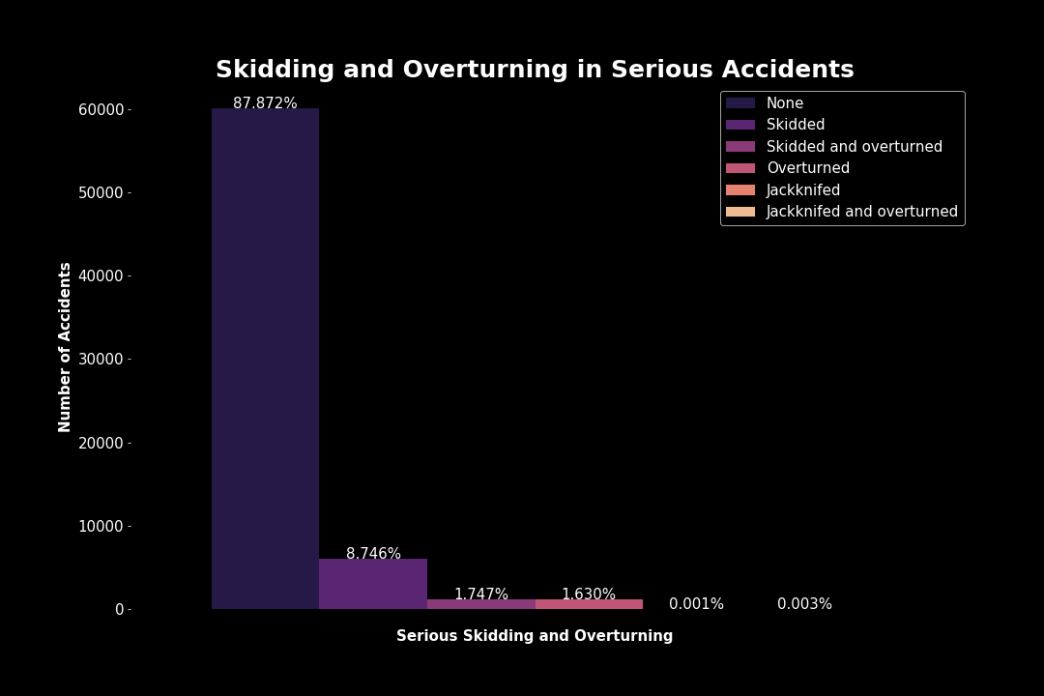
Skidding or Overturning
Higher percentages of serious accidents involved skidding, jackknifing or overturning.

Slide 20
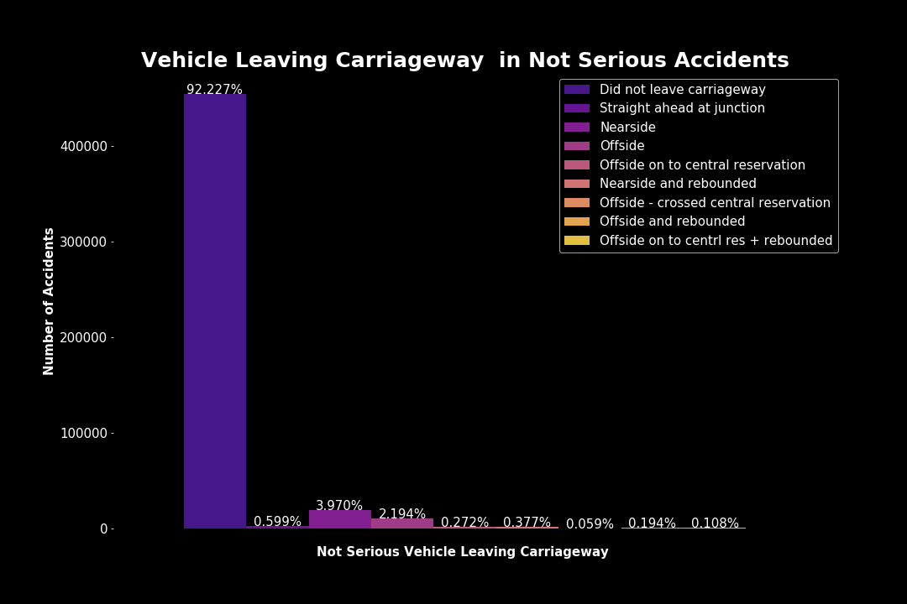
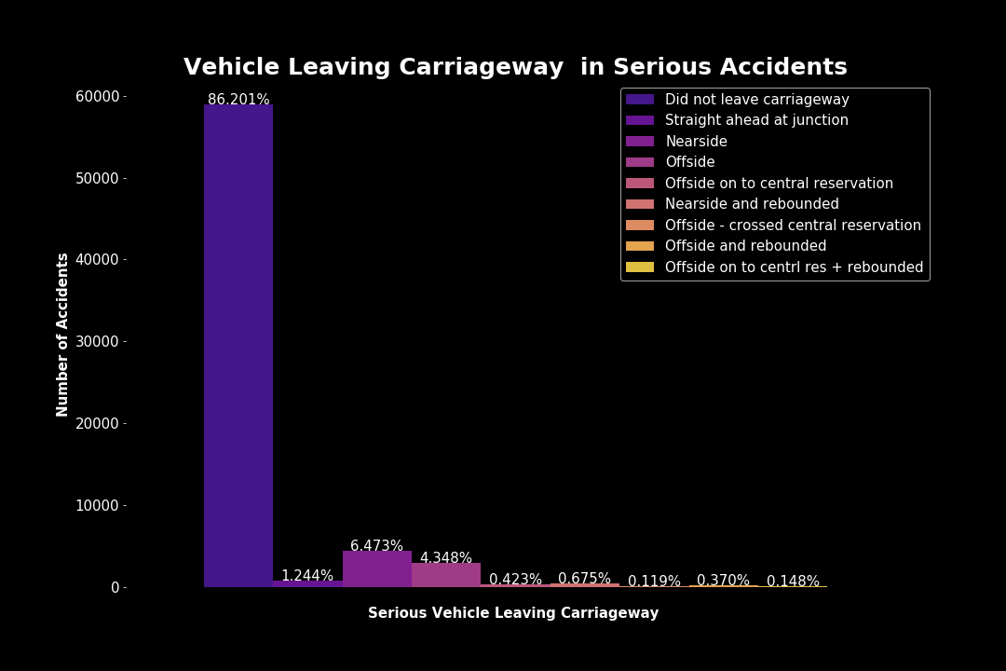
Vehicle Leaving Carriageway
Most vehicles did not leave the carriageway in either type of accident, however serious accidents had higher percentages of those that did leave the carriageway.

Slide 21
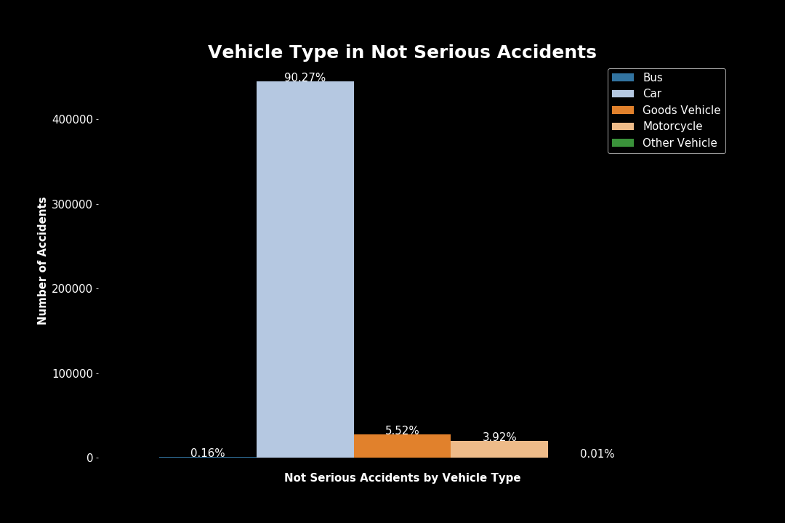
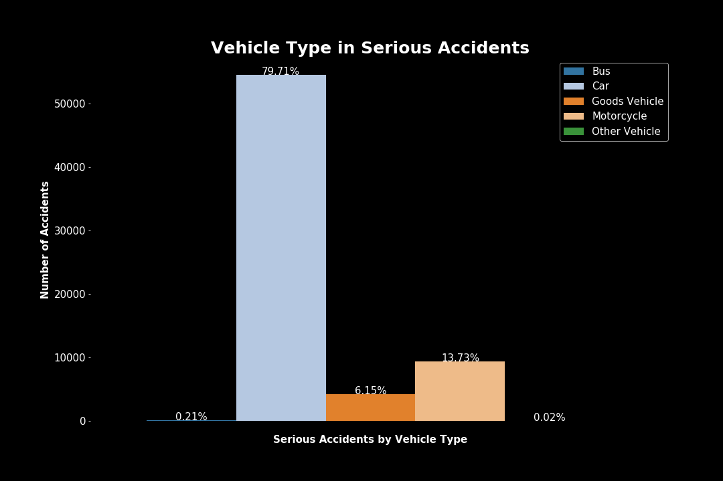
Vehicle Type
Motorcycles were involved in a significantly higher percentage of serious accidents than not serious accidents.

Slide 22
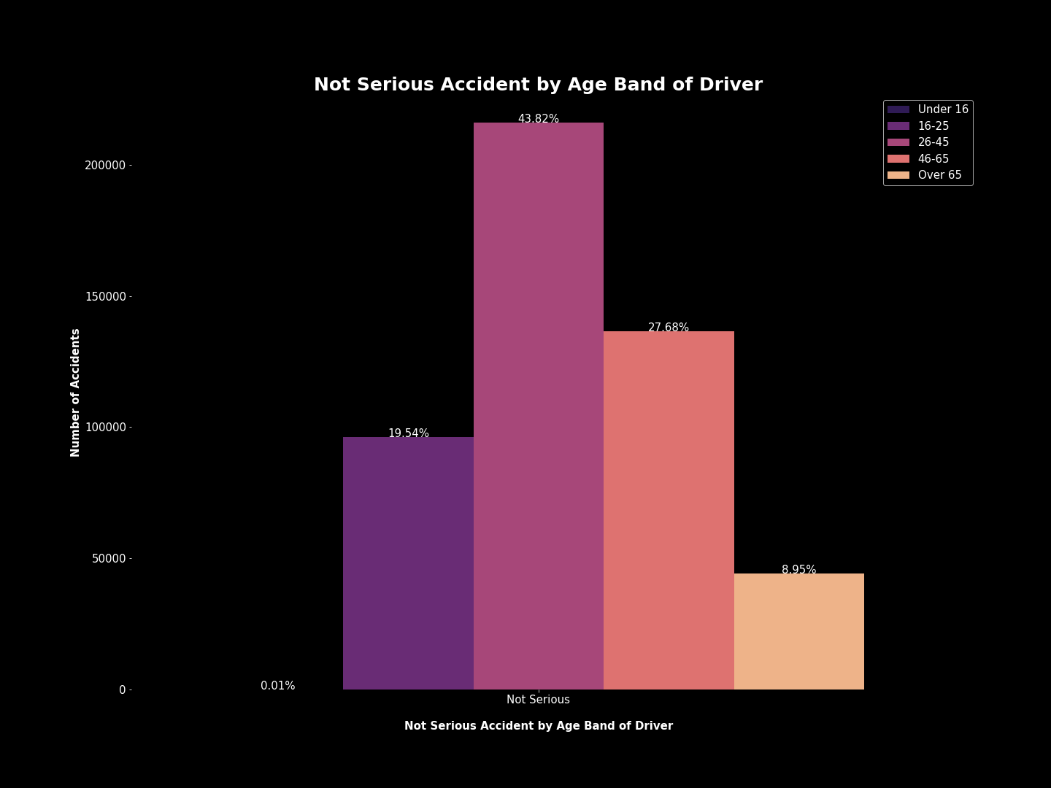
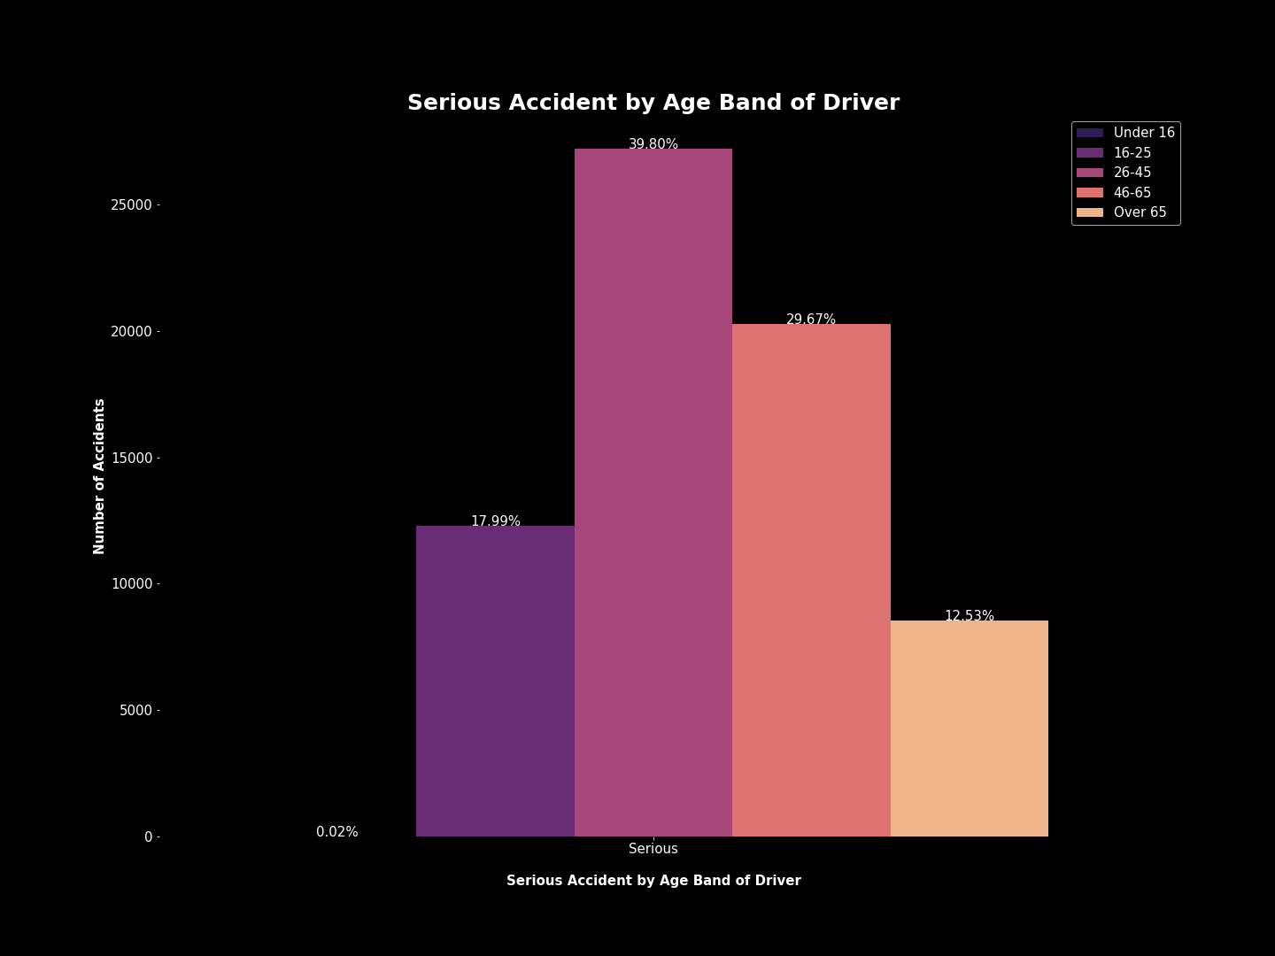
Age Band of Driver
The age groups over the age of 25 had a higher percentage of serious accidents than not serious.

Slide 23
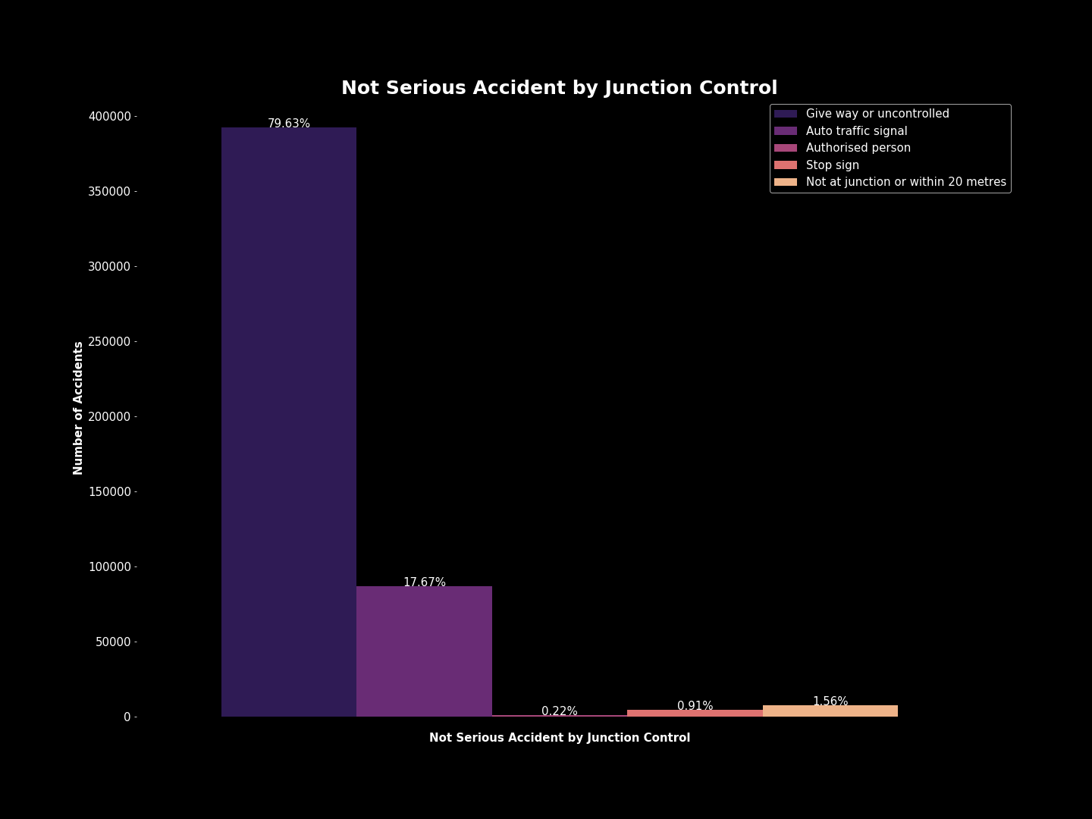
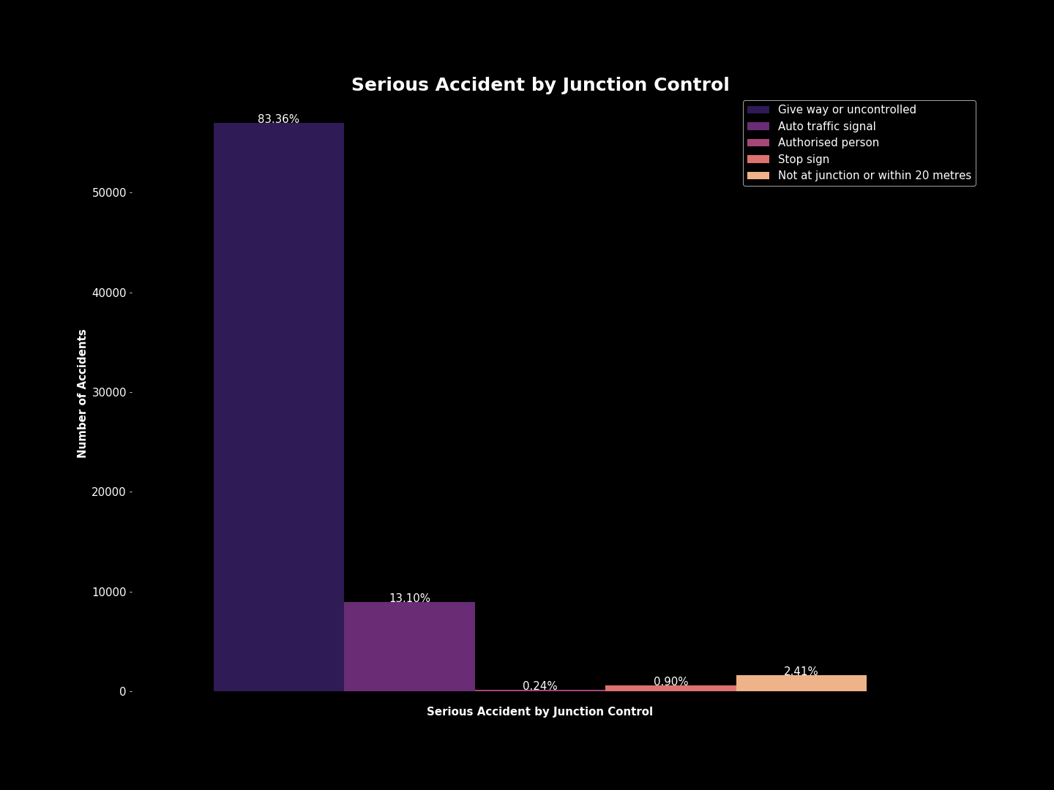
Junction Control
Most areas with accidents were uncontrolled.

Slide 24
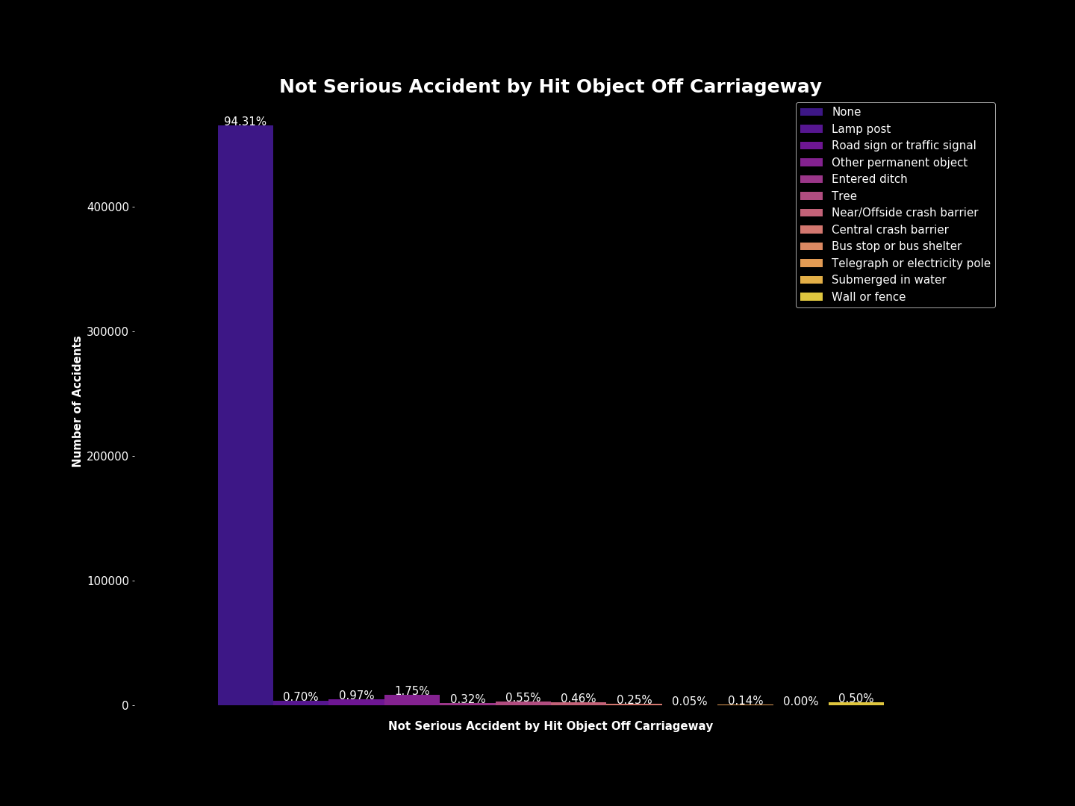
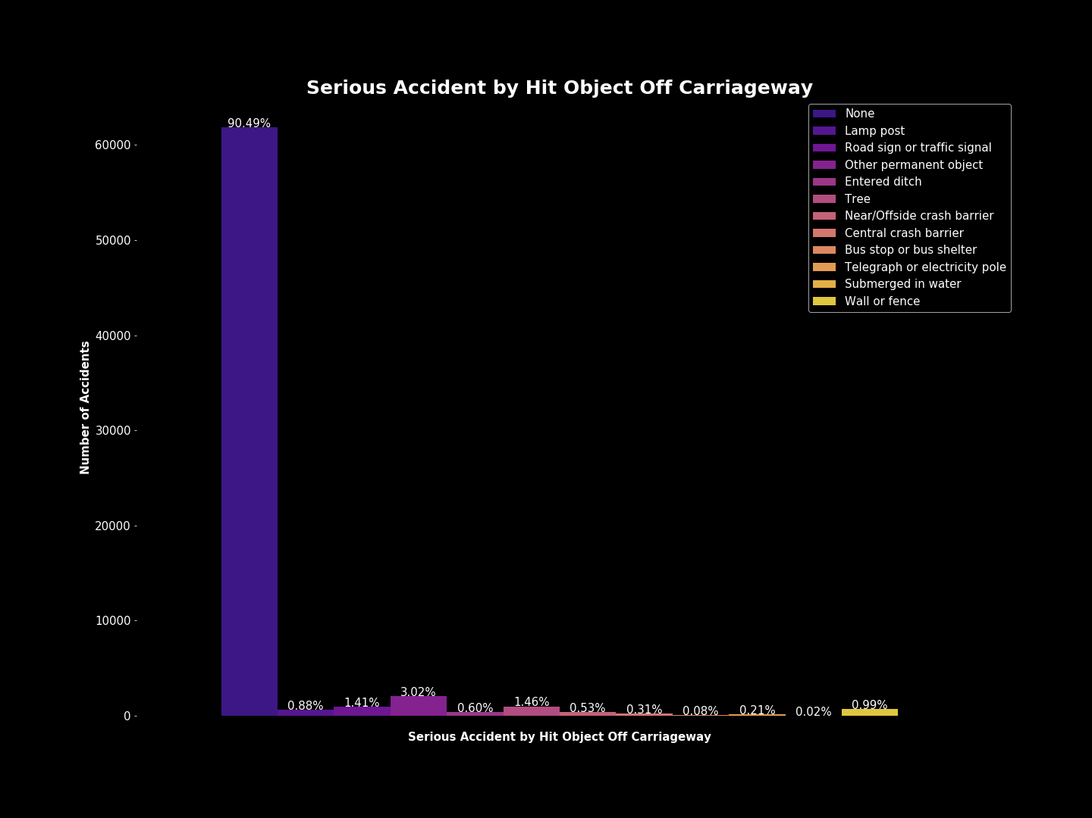
Hit Object Off Carriageway
Most accidents did not involve objects being hit off the carriageway, however serious accidents had higher percentages of accidents that did involve hitting an object off the carriageway.

Slide 25
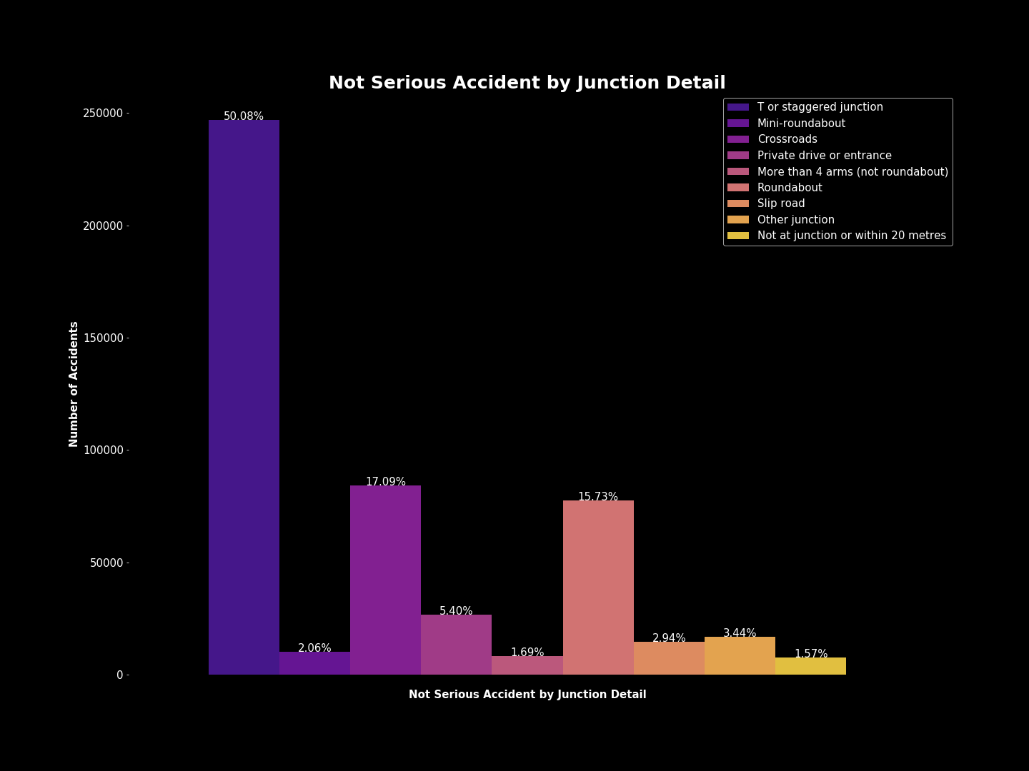
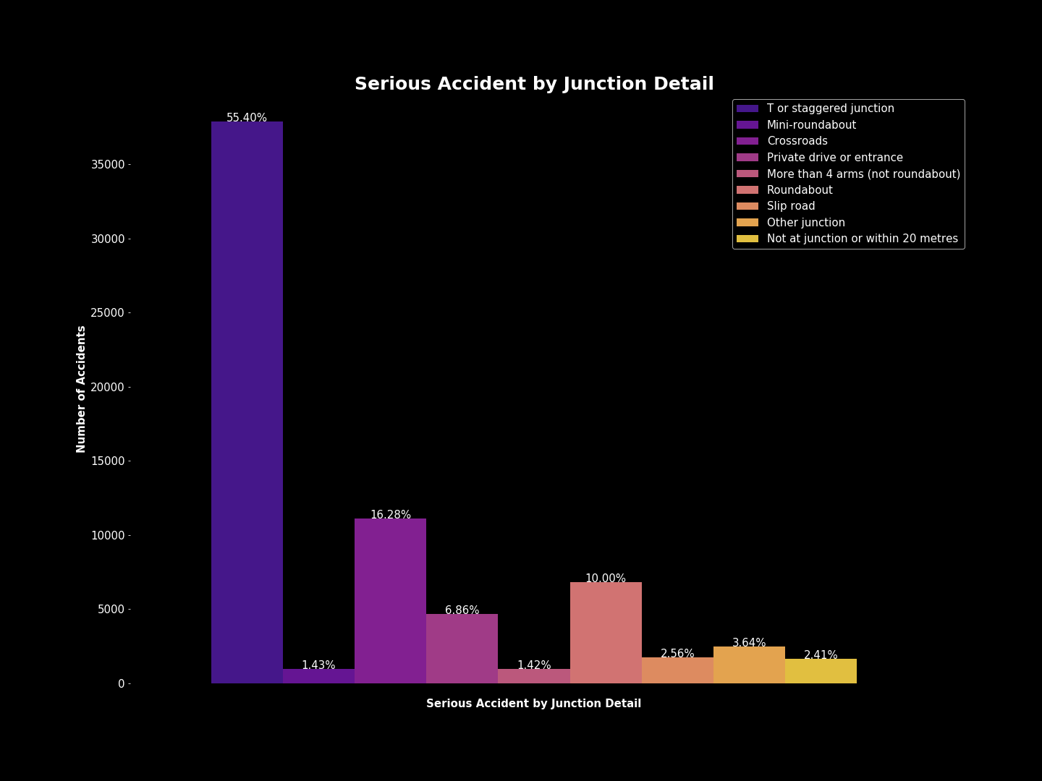
Junction Detail
T or staggered junctions were where most of the accidents occurred.

Slide 26
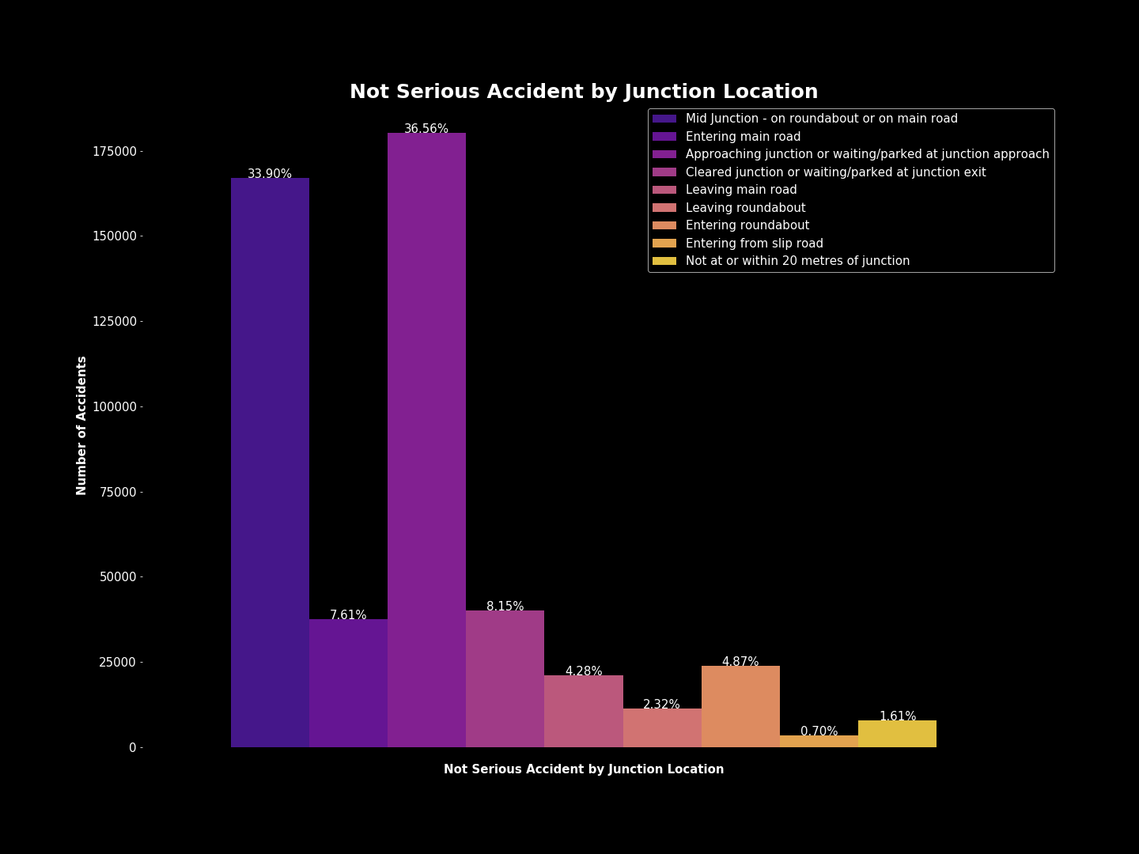
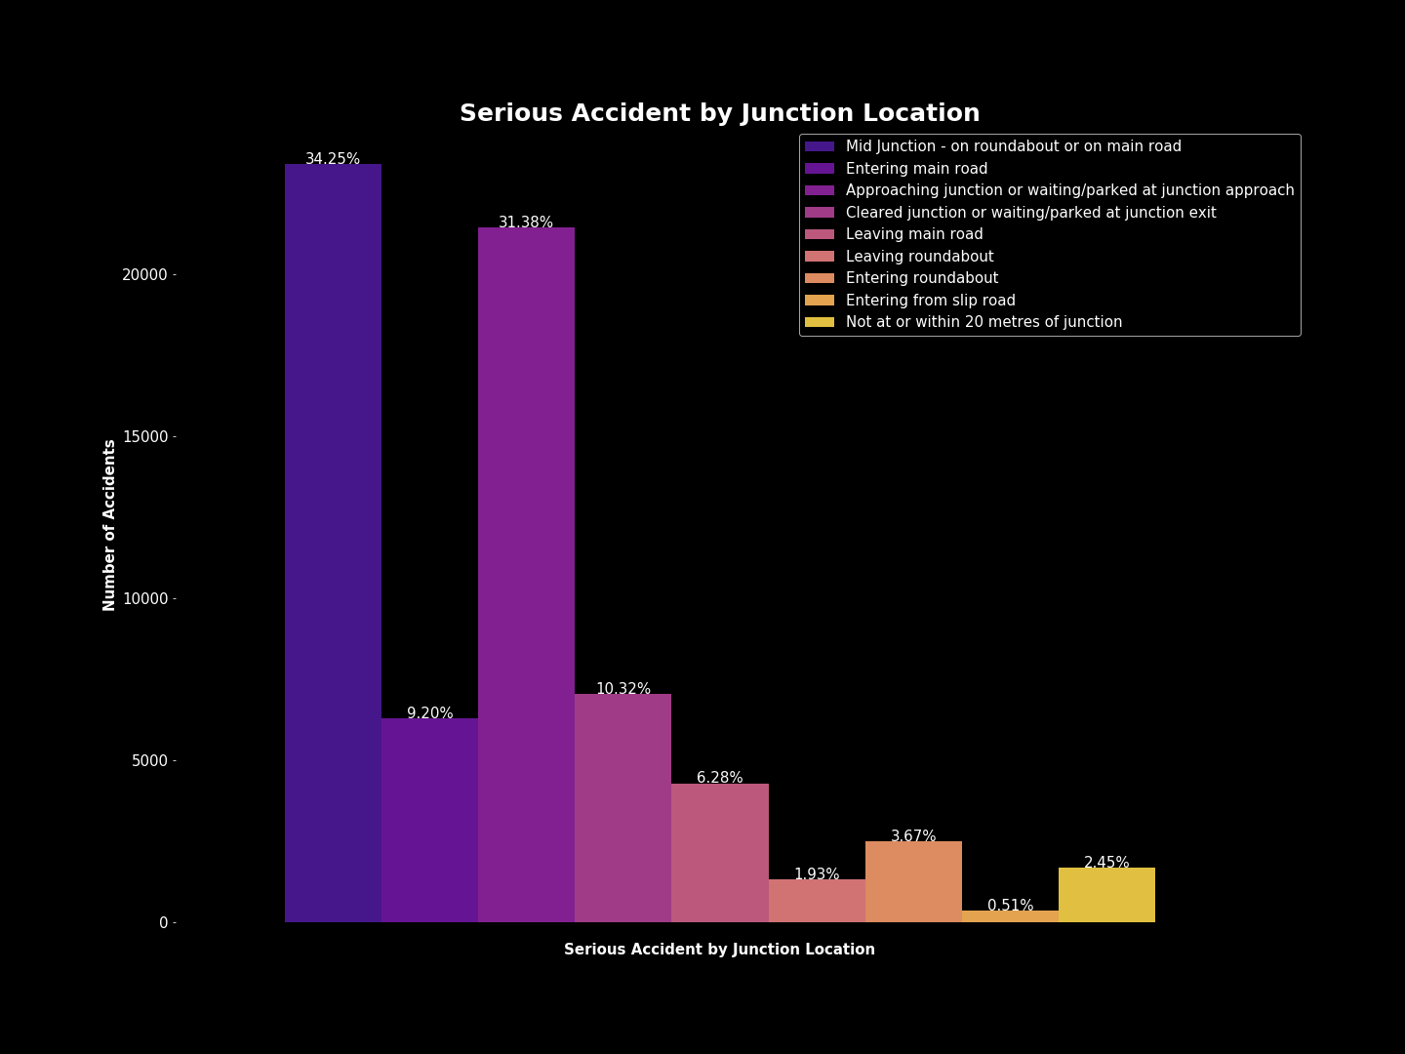
Junction Location
Most accidents seem to have occurred in the “Mid Junction - on roundabout or on main road” or situations where the driver was “approaching the junction or waiting/parked at junction approach”.

Slide 27
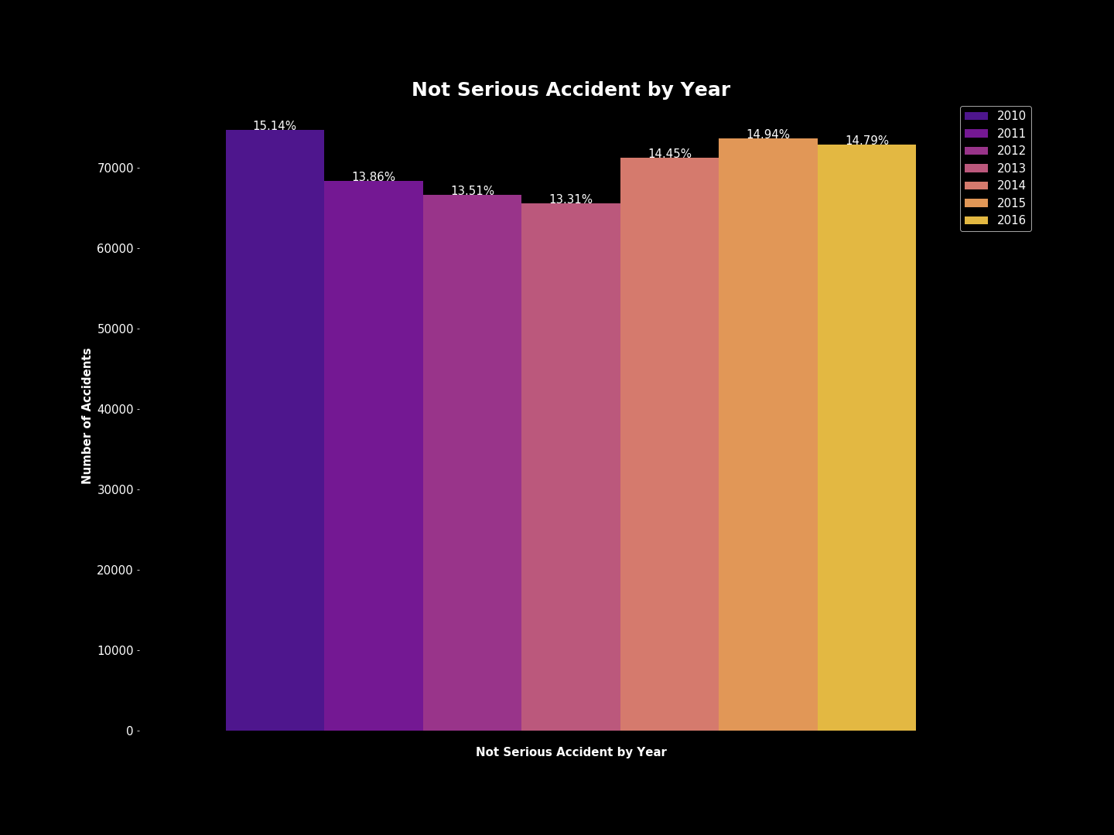
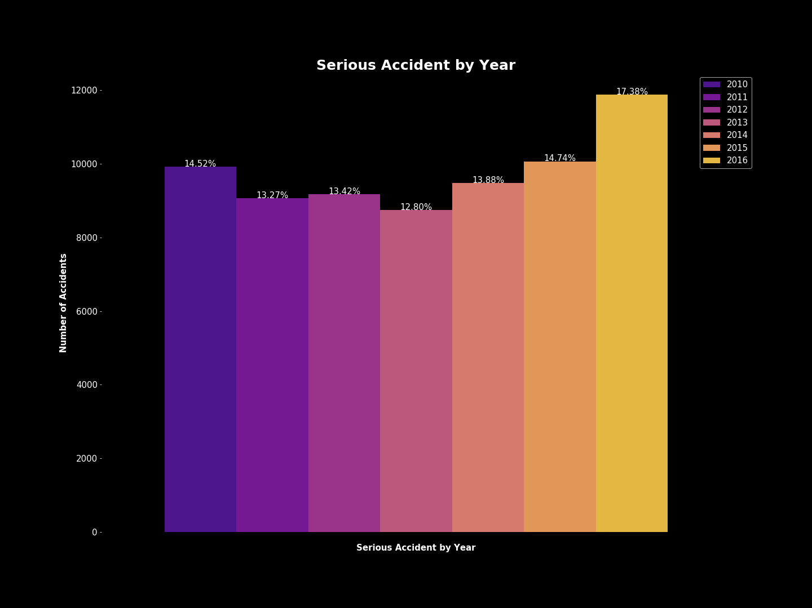
Year
There has been a spike in percentage of serious accidents over the years. However, the percentage of not serious accidents has remained somewhat consistent.

Slide 28
Visualizations Summary
did_police_officer_attend_scene_of_accident: Police attended most accidents but were less likely to NOT be called in serious accidents.
x1st_point_of_impact: Majority of accidents were front impacted as the first point of impact. Not serious accidents had a higher percentage of Back impact accidents than serious accidents. Serious accidents had higher percentages of Offside and Nearside accidents.
number_of_vehicles: Nothing significant.
speed_limit: Majority of accidents occurred in 30 speed limit zones. It would have been beneficial to have actual data on the speeds of the vehicles involved or at least if they were speeding.
urban_or_rural_area: Rural areas had a higher percentage of serious accidents. This may relate to hospital locations or emergency vehicle arrival data which was not available.
skidding_and_overturning: Higher percentages of serious accidents involved skidding, jackknifing or overturning.
vehicle_leaving_carriageway: Most vehicles did not leave the carriageway in either type of accident, however serious accidents had higher percentages of those that did leave the carriageway.
sex_of_driver: Men were more involved in both serious and not serious accidents, however according to racfoundation.org, there are only 355 of female privately registered cars on UK roads.
vehicle_type: Motorcycles were involved in a significantly higher percentage of serious accidents than not serious accidents
vehicle_manoeuvre: Nothing significant.
driver_home_area_type: Rural and Small Towns has higher percentages of serious accidents. This may relate to hospital locations or emergency vehicle arrival data which was not available.
age_band_of_driver: The age bands over the age of 25 had a higher percentage of serious accidents than not serious.
junction_control: Most areas with accidents were uncontrolled.
hit_object_off_carriageway: The majority of accidents did not involve objects being hit off the carriageway, however serious accidents had higher percentages of accidents that did involve hitting an object off the carriageway.
hit_object_in_carriageway: Most accidents did not involve objects being hit in the carriageway; however serious accidents had higher percentages of accidents that did involve hitting an object off the carriageway.
driver_imd_decile: Nothing significant. Most accidents occurred in areas that were Less deprived 20-30%
junction_detail: T or staggered junctions were where most of the accidents occurred.
junction_location: Nothing that separates the two serious types. However, most accidents seem to have occurred in Mid Junction - on roundabout or on main road or situations where the driver was approaching junction or waiting/parked at junction approach.
propulsion_code: Diesel, Fuel cells, New fuel technology, vehicles were not recorded as a part of serious accidents.
year: There has been a spike in percentage of serious accidents over the years. However, the percentage of not serious accidents has remained somewhat consistent

Slide 29
Other Visualizations
Junction Control by Junction Detail
Junction Control by Junction Location
First point of Impact by Junction Detail
First point of Impact by Junction Location
Junction Control and First Point of Impact
Due to the previous visualization a comparison of certain variables was desired to see more correlations. The comparisons listed above will be displayed in the slides to follow.

Slide 30
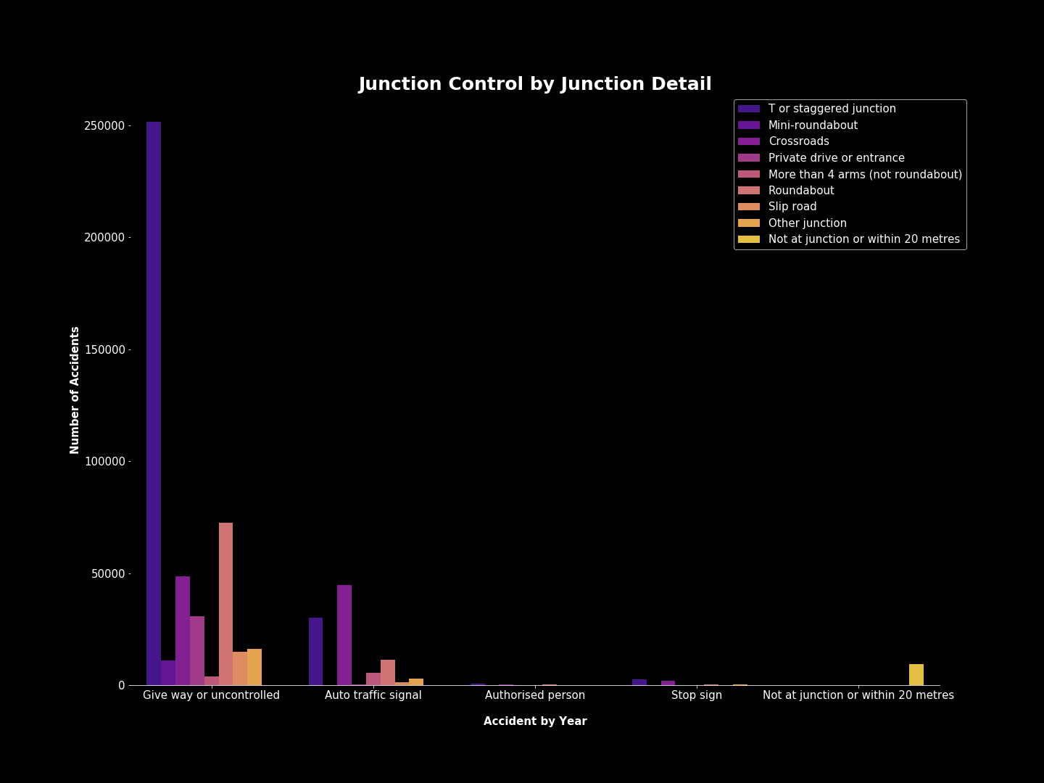

Slide 31
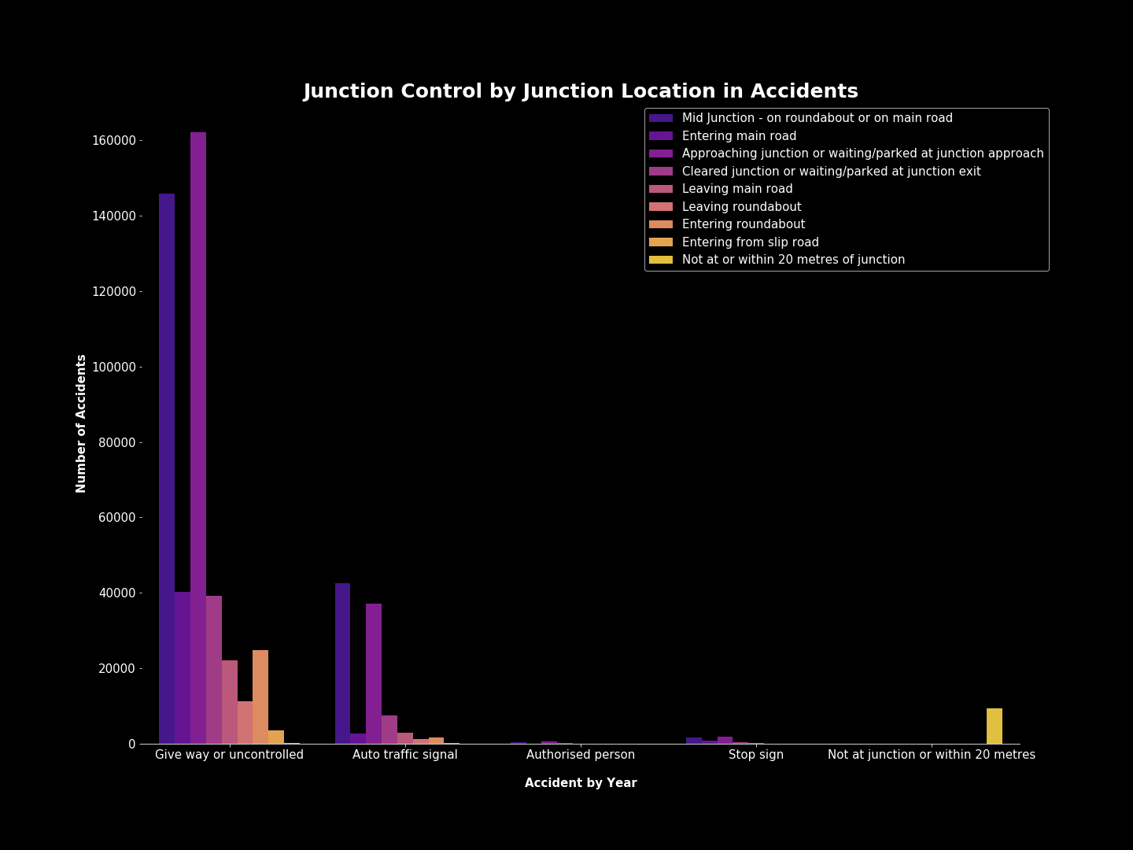

Slide 32
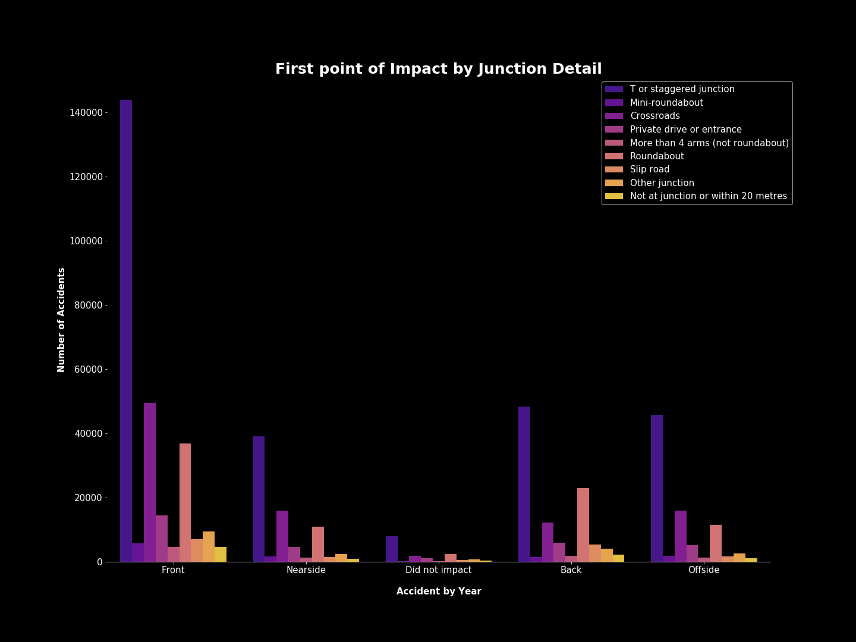

Slide 33
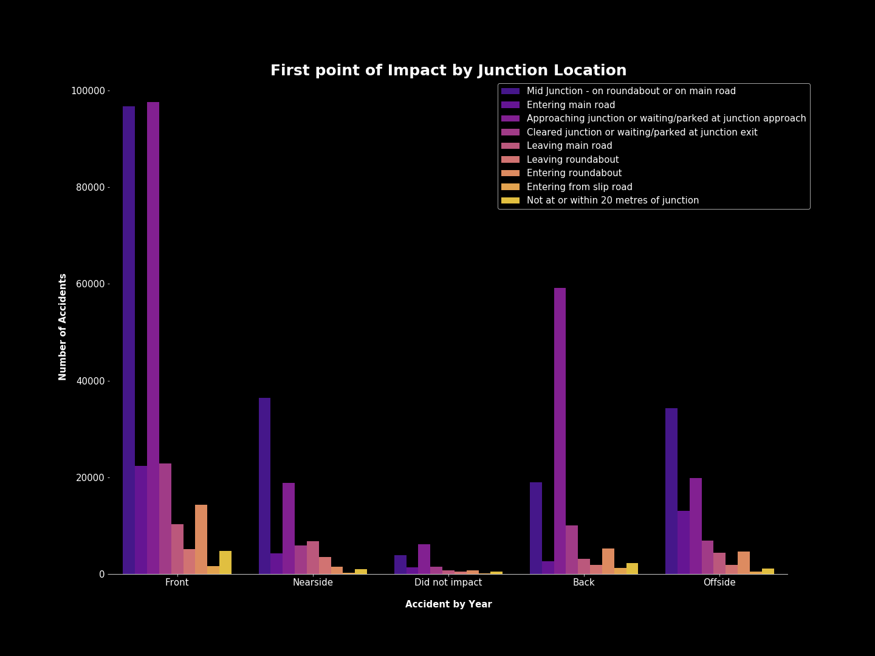

Slide 34
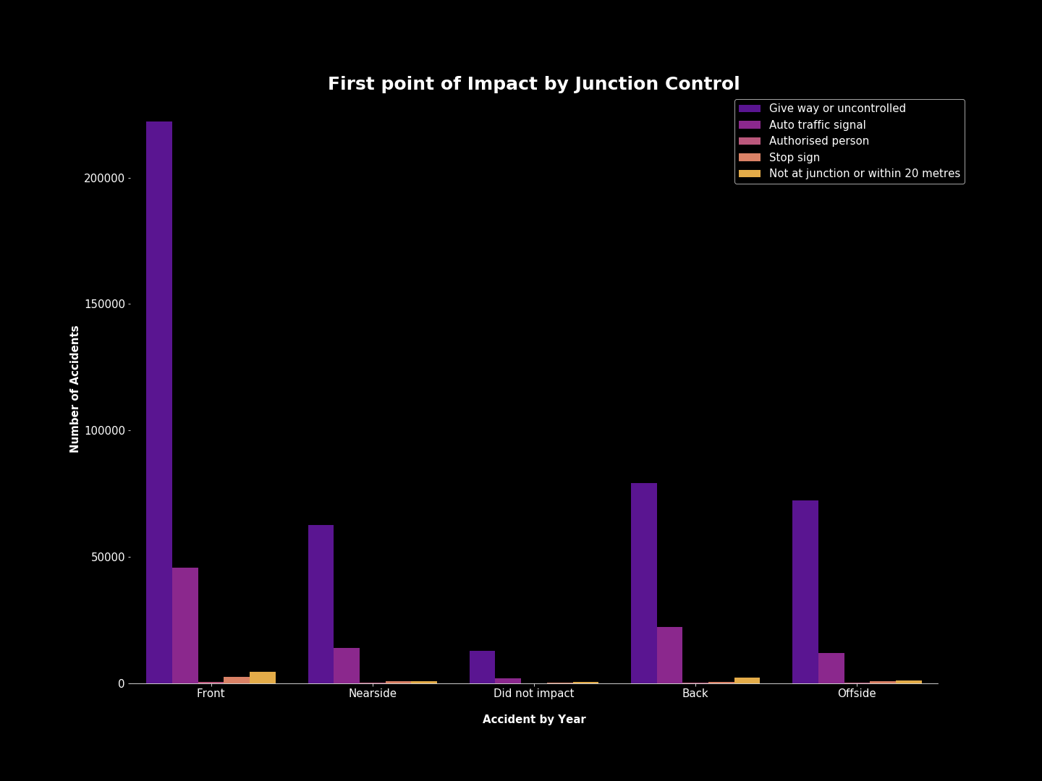

Slide 35
Other Visualizations Summary
No matter the situation above, the most accidents were involving areas that were uncontrolled. One of the main areas where this happened was in the Junction Detail T or staggered junction.
Other areas of concern include accident locations that included Mid Junctions on roundabouts or main roads.
No matter the location, detail, or location of impact the common denominator seems to be a lack of signage or control in junction areas.

Slide 36
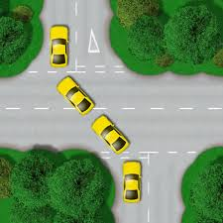
Possible Solution
From the data above more controlled areas would be beneficial. Maybe signs alerting drivers of the upcoming junctions, traffic lights, or stop signs would help in some of these areas where they are feasible.
For example, this is a staggered junction, the main junction detail in accidents. One can understand how a situation such as these can lead to numerous accidents especially if proper signage is not available. Perhaps traffic lights, stop signs, or warnings indicating that they are approaching certain junctions would help reduce accidents.

Slide 37
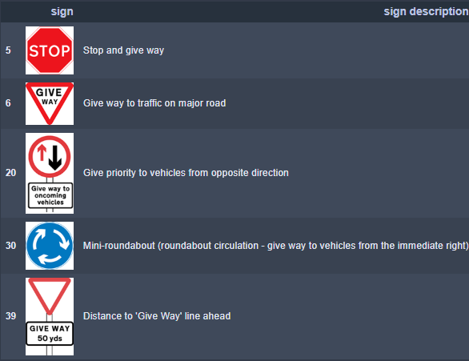
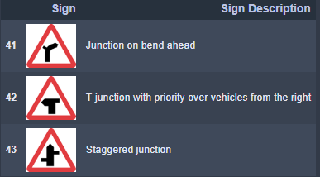
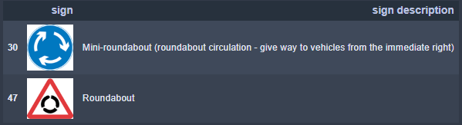
Signage Options
The following images were obtained through web scraping of the website Learner Driving Centres which contains information on road signs in the UK.

Slide 38
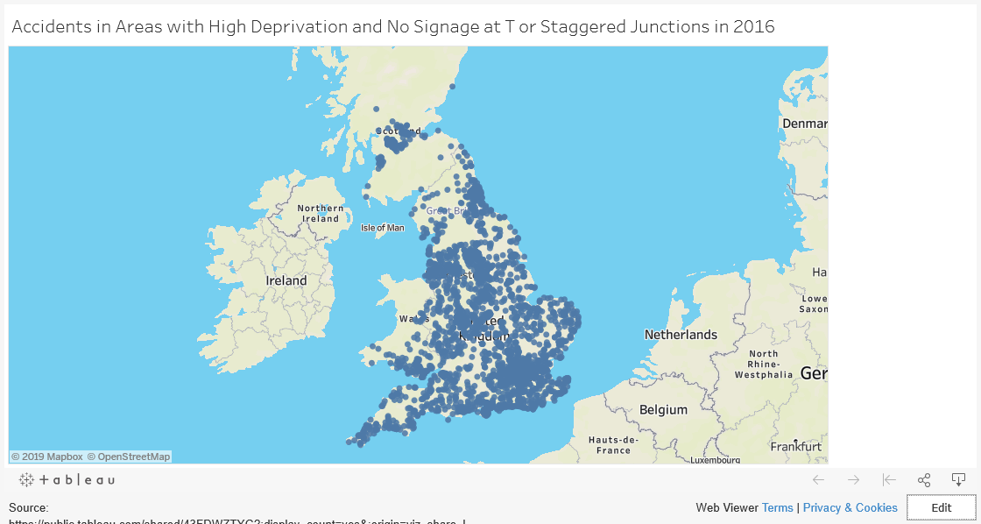

Slide 39
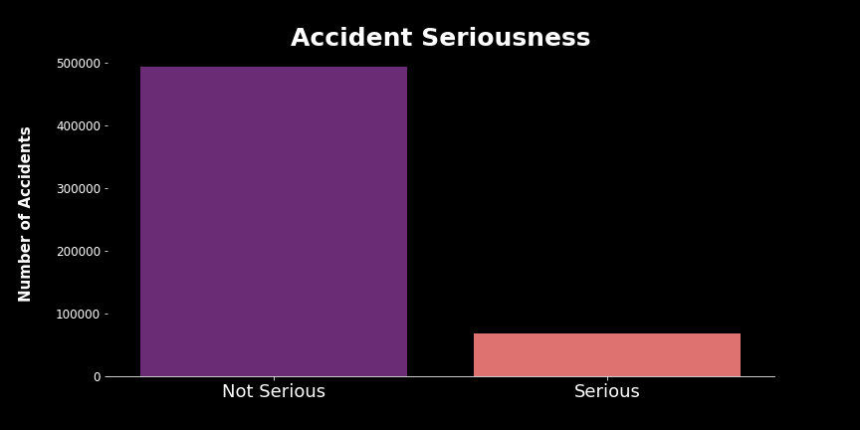
Can we create a machine learning algorithm that correctly predicts the severity of accidents?
The data in this dataset is extremely imbalanced for what we are trying to predict (see graph). We resampled the data as undersampling, where we reduce the number of majority (Not Serious Accidents) samples.
The machine learning classifier algorithms that we are going to use are as follows:
Bagging Classifier (sklearn)
AdaBoost Classifier (sklearn)
Random Forest Classifier (sklearn)
LightGBM Classifier (LightGBM)
XGBoost Classifier (xgboost)
Balanced Bagging Classifier(imblearn)
Easy Ensemble Classifier (imblearn)
Balanced Random Forest Classifier (imblearn)

Slide 40
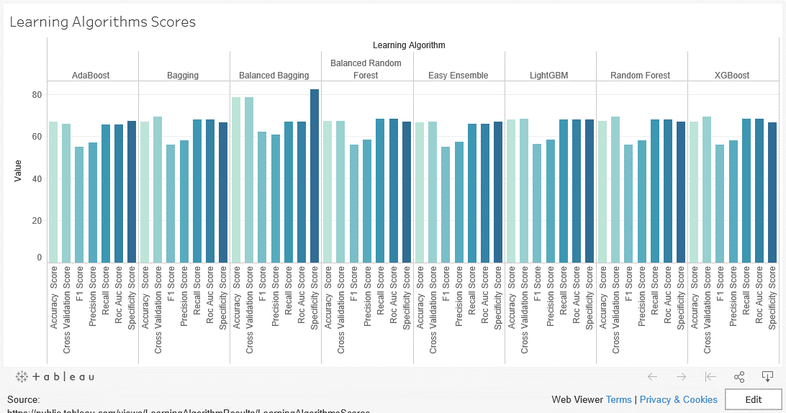

Slide 41
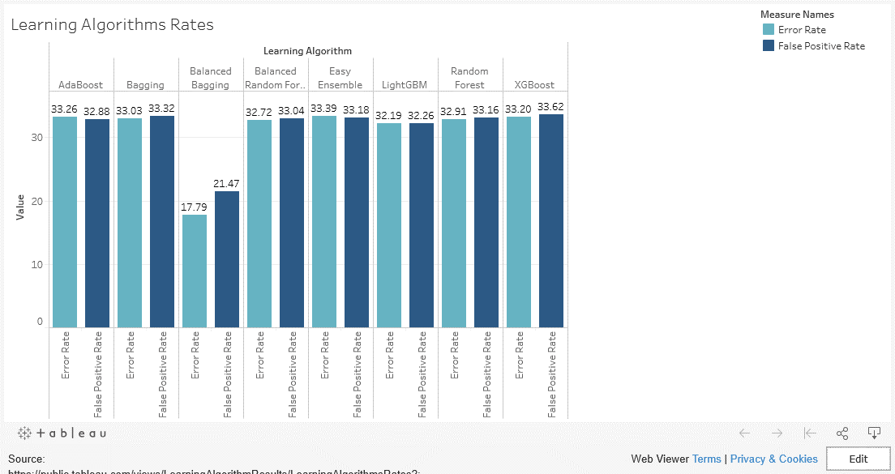

Slide 43
Balanced Bagging Classifier
Based on the previous visualizations, Balanced Bagging Classifier from imblearn is the algorithm of choice for this data. While some of the scores may have been close, Balanced Bagging Classifier had higher scores in Accuracy, Cross Validation, and Specificity. The algorithm also had the lower Error Rate and False Positive Rates of the group.
Balanced Bagging Classifier performed the best of the classifiers, however, I was not comfortable with how close its predictions were for Serious Accidents in the confusion matrix. Due to this, I decided to combine Balanced Bagging Classifier with the second highest performing algorithm, LightGBM to see what results I would get.

Slide 44
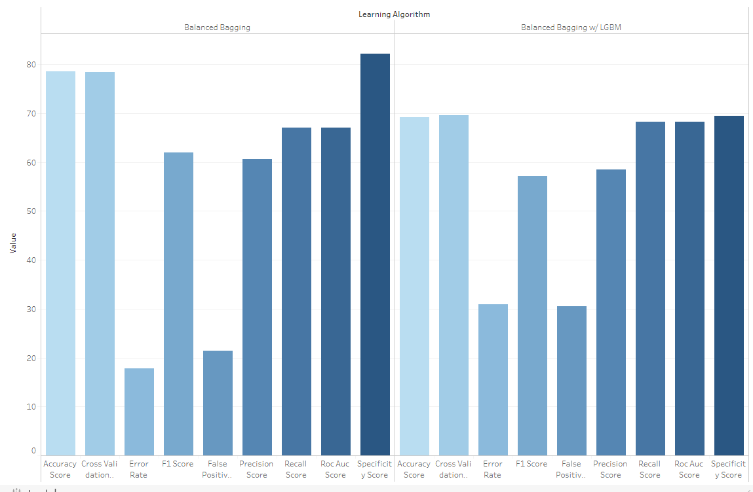
Balanced Bagging Classifiers Comparison
The results were better than the other learning algorithms but lower accuracy wise than the previous Balanced Bagging Algorithm. It also took longer than any other algorithm used. Taking all of that into consideration, I have decided that depending on what was the goal, either Balanced Bagging Classifier algorithm could be used. If I were more concerned with overall accuracy, the regular Balanced Bagging Classifier would be used. If I were more concerned with making sure "Serious" predictions were achieved, Balanced Bagging Classifier with LightGBM would be used.

Slide 45
Expectations vs Reality
Expectation
Reality
Overall I thought there would be certain features that had a high impact on the severity of accidents.
skidding_and_overturning
time_of_day
weather_conditions
day_of_week
There were very low correlations among features and accident severity. The highest correlation was vehicle_type at 0.134.

Slide 46
Limitations
Not able to obtain accuracy over 70% without causing other issues such as overfitting and bias.
The data was extremely imbalanced. The majority of accidents were not serious and while this is not a real life problem, it was a problem for this model. Undersampling was done to improve overall scoring.
More factors surrounding accidents should be included in this data.
While there was information on the speed limit in certain areas, there was no information on whether the driver was speeding.
No information on cellphone usage of drivers
Rural areas had a higher rate of serious accidents which could be correlation to emergency vehicle arrival or distances from hospitals, but this information was also not available
No time of arrival for emergency units
No info on passengers
Low correlations

